Slide 1
Citizen participation
Anne Graumans
www.annegraumans.nl
28 May 2022

Slide 2
Participation ladder
Co-decide
Co-produce
Advice
Consult
Inform

Slide 3
Conditions for participation
Motivation – does the organisation have the right mindset?
Equal position regarding available information – do citizens have the same access to information?
Space for participation – for adjustments – is there enough opportunity to listen to citizens and adjust the plans?
Facilitation of citizens – is the organisation equipped to facilitate citizens? Is there enough time, budget, people?

Slide 4
Is the answer
NO
Than do not start a participation process
If yes: mark the type of the participation on the ladder

Slide 5
Choose the right form of participation to avoid frustration and disappointment
Co-decide => Citizens have a say if a project will be implemented or not
Co-produce => Citizens and government produce together
Advice => Citizens give advice, local government listens and adjusts the project
Consult => Citizens are consulted, often in an early phase
Inform => Citizens are informed, but do not have a say.

Slide 6
Examples United Kingdom
Right to Challenge (2011)
the right for community organisations to submit an expression of interest in running services of local authority and fire and rescue authorities on behalf of that authority.

Slide 7
Examples Belgium
G-1000
1.. Public Agenda Setting => Online
2. Citizen’s summit => Invitation 1000 citizens!
3. Citizen’s panel => 32 citizens continue work of step 1 and 2
More info

Slide 8
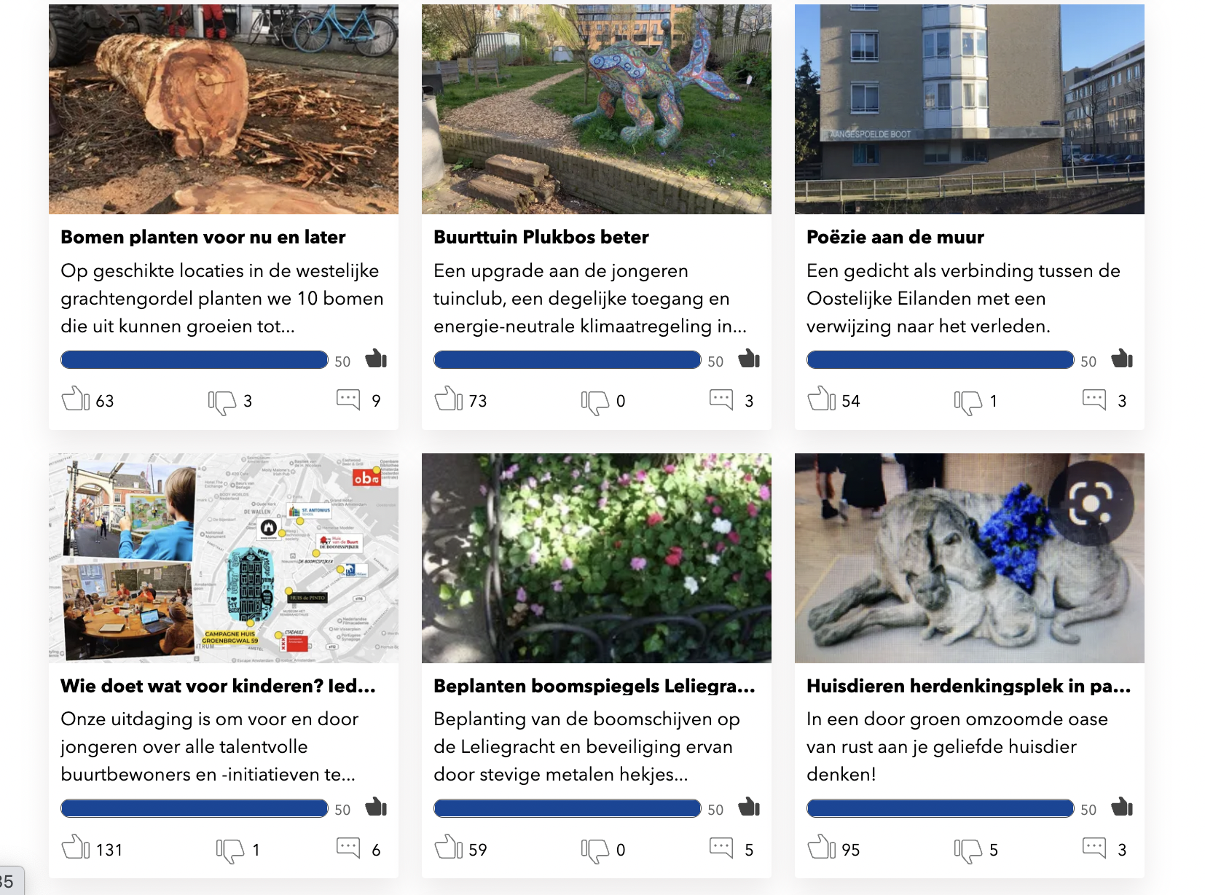
Examples The Netherlands
Voice of neighbourhood
Submit plan
Plans with 50 likes proceed
Feasibility test
Discussion in city council
Implementation

